Slide 1
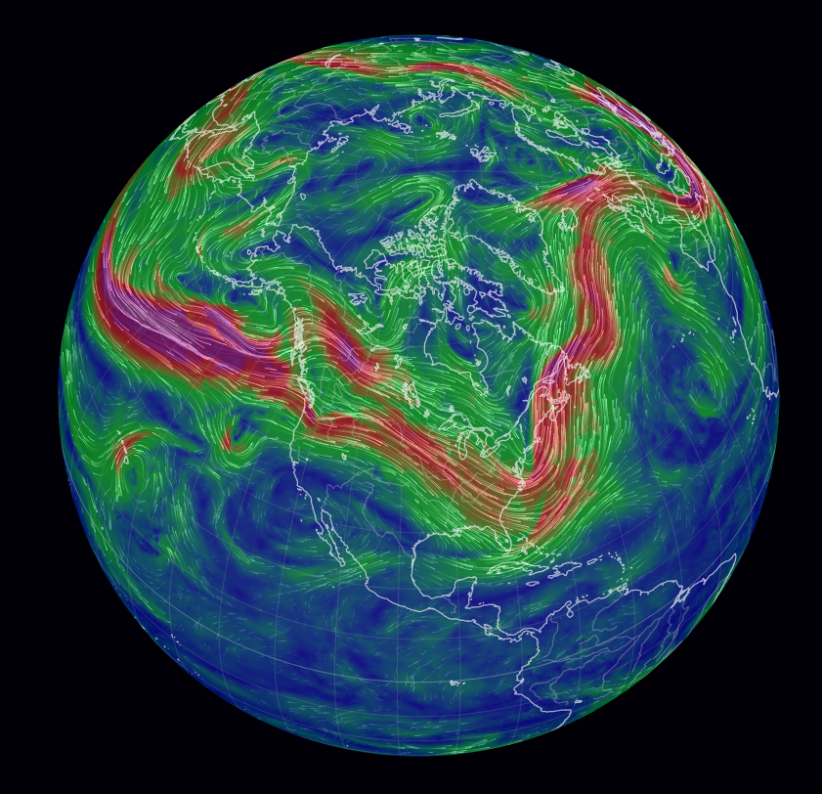
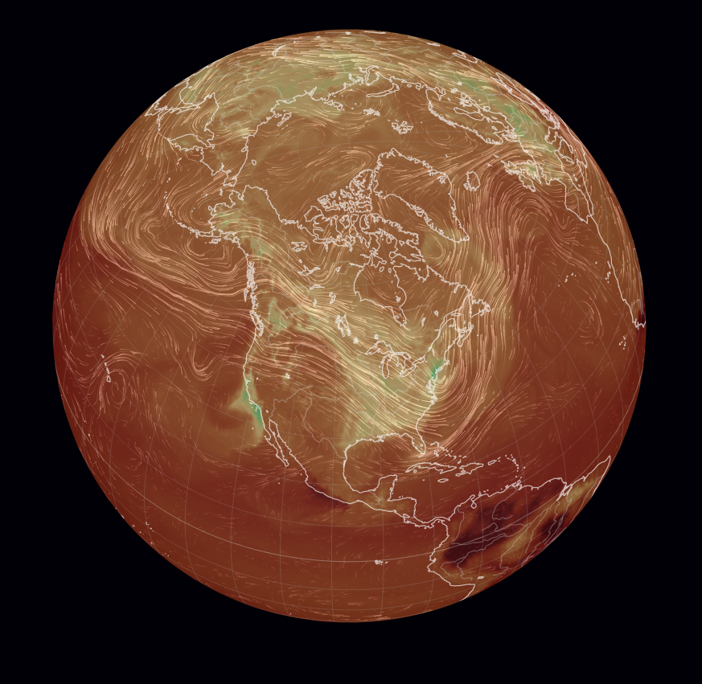
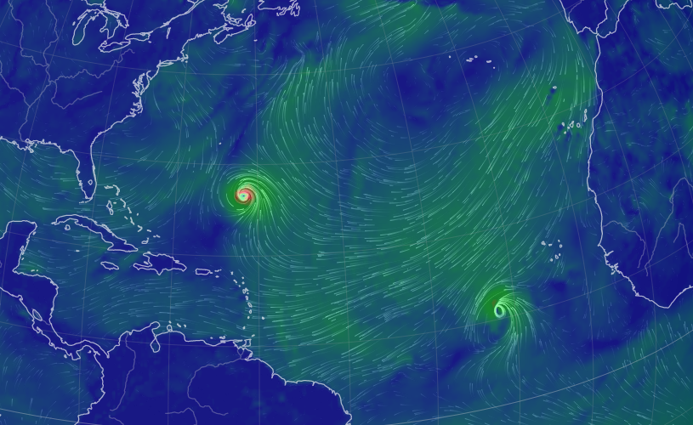
Week 1 - From weather to climate
Synoptic systems
Upper-atmosphere winds
CO₂ and other pollutants

Slide 2
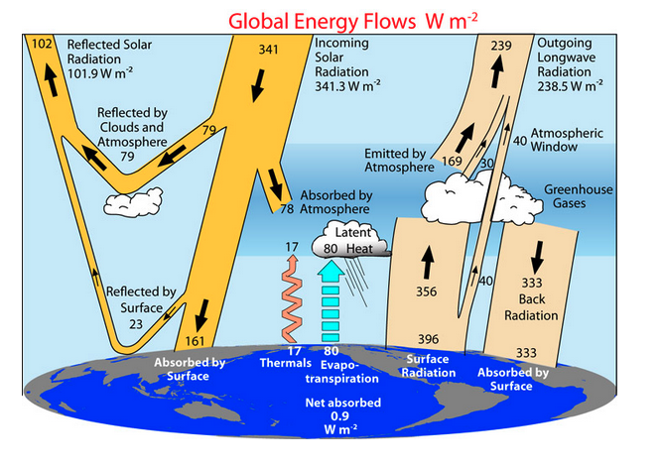
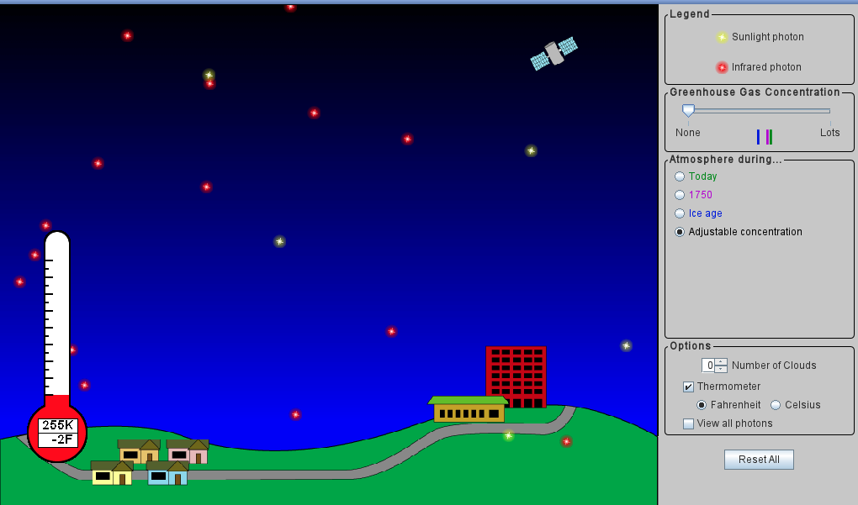
Week 2 - Radiative balance
Key lesson learned: If albedo drops by just 0.01 (say, from 0.3 to 0.29), expect temperature increase of +1 ºC.

Slide 3
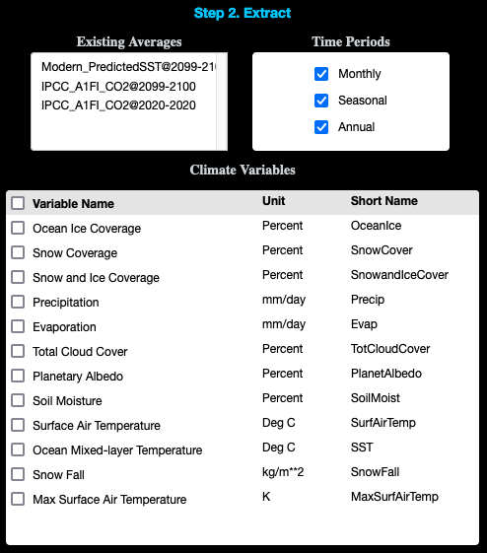
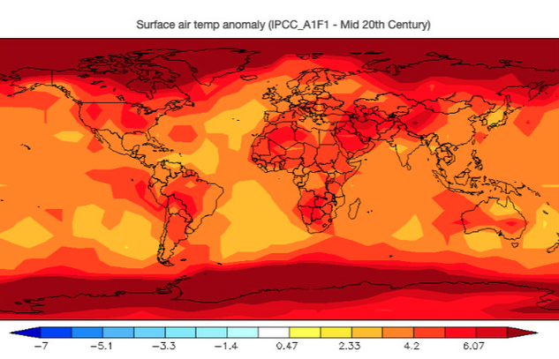
Weeks 3 & 4 - EzGCMs

Slide 4
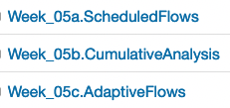
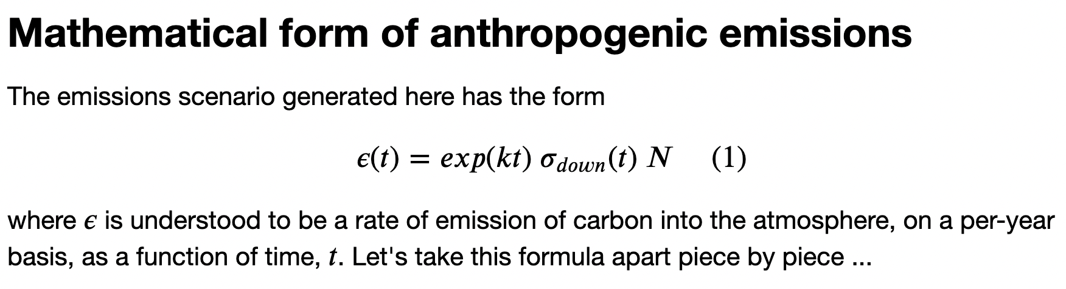
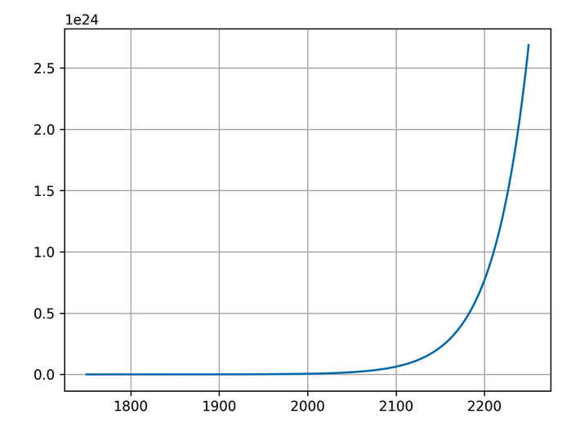
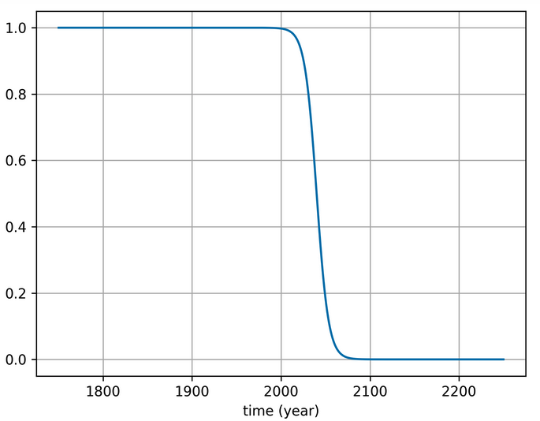
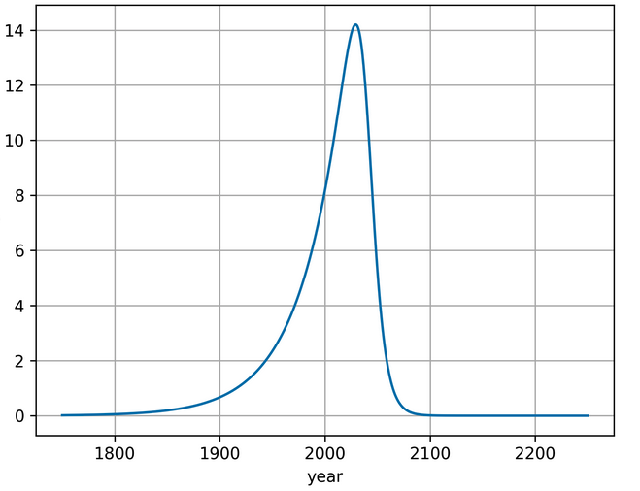
Week 5 - Scheduled and adaptive flows

Slide 5
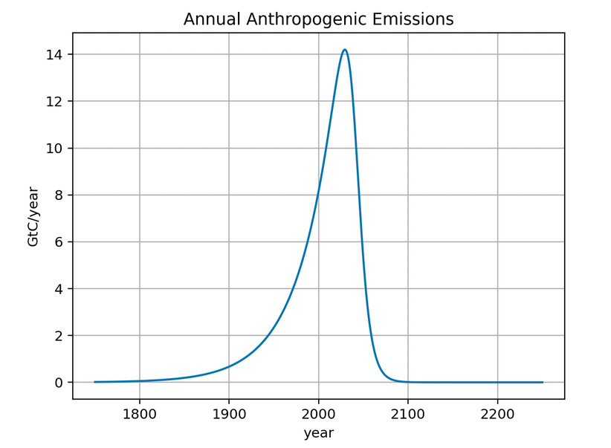
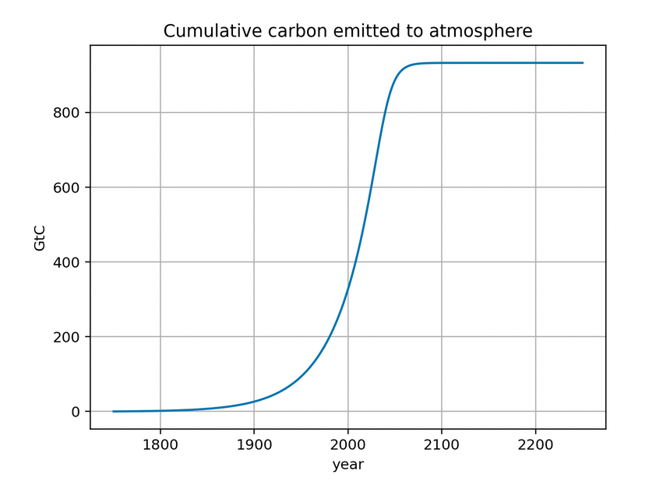
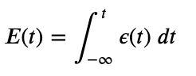
Week 5 - Scheduled and adaptive flows

Slide 6
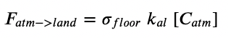
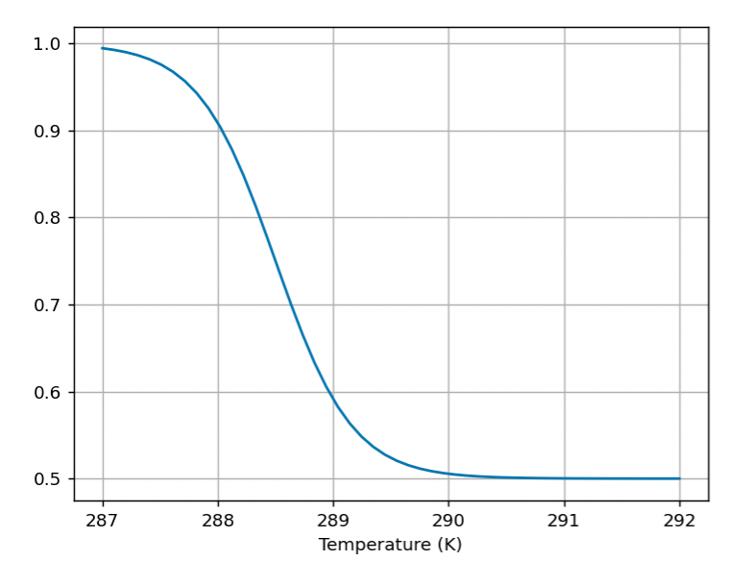
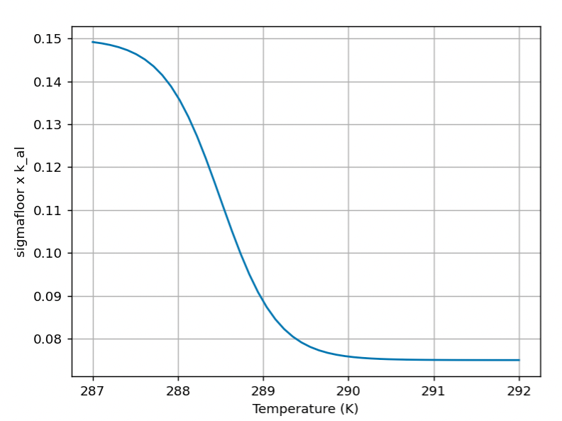
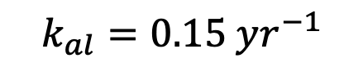
Week 5 - Scheduled and adaptive flows
$$k_{al}=0.15 yr^{−1}$$

Slide 7
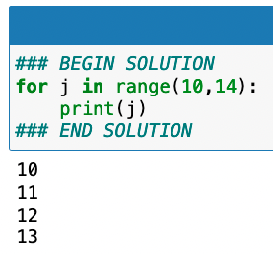
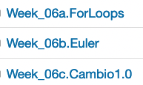
Week 6 – Atmosphere-ocean box model (Cambio1.0)

Slide 8
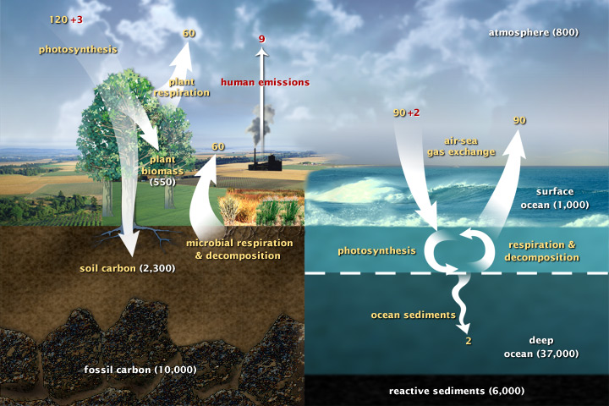
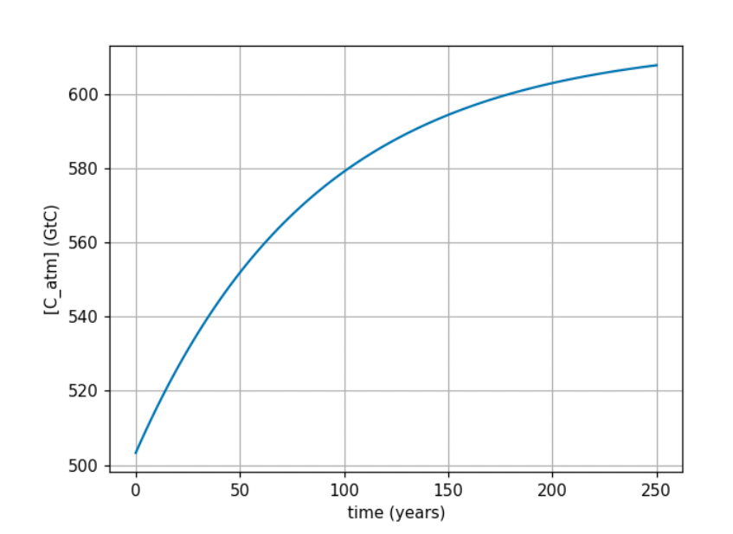
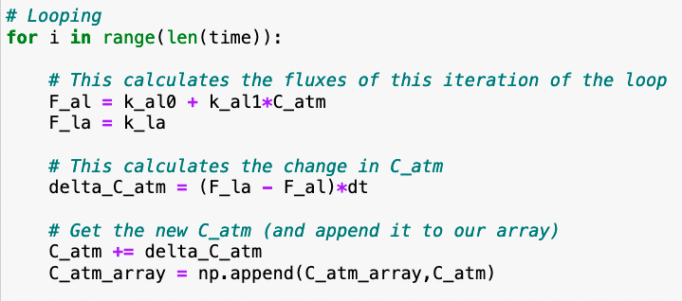
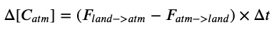
Week 6 – Atmosphere-ocean box model (Cambio1.0)

Slide 9
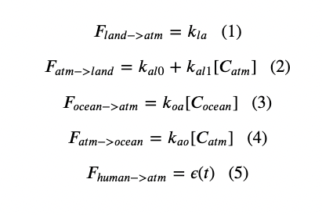
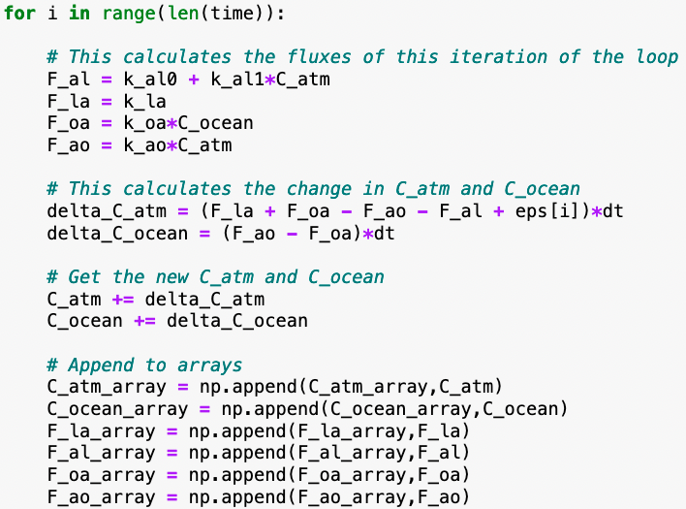
Week 6 – Atmosphere-ocean box model (Cambio1.0)

Slide 10
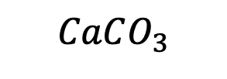
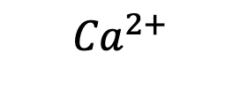
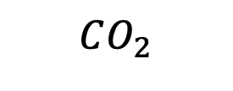
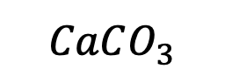
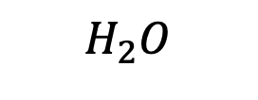
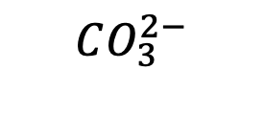
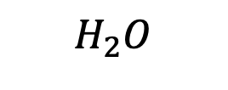
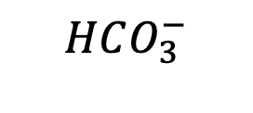

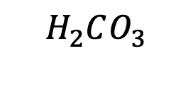
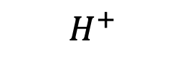
Week 7 – Ocean acidification
Air
$$CO_{2}$$
Battery acid
$$H_{2}O$$
$$H_{2}O$$
Oceans
$H_{2}CO_{3}$
$$H^{+}$$
$$H^{+}$$
$$HCO_{3}^{−}$$
$${Ca}^{2+}$$
$$CO_{3}^{2−}$$
Sea floor
$$CaCO_{3}$$
$$CaCO_{3}^{}$$
Sodium hydroxide (active ingredient in DranoTM)

Slide 11
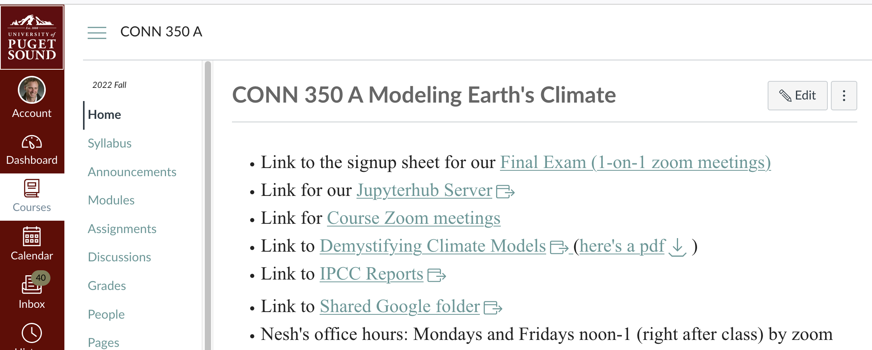
About the 1-on-1 interview (during Finals Week)
Sign up for a slot here:
Last year, this is what we covered:

